Slide 1
Advanced I/O Concepts

Slide 2
FORMAT Descriptors
A complete list of the Fortran 95/2003 format descriptors is presented in Table 14-1 of the text.
There are Twelve descriptors that describe I/O data types for single and double-precision real values:
D – Double precision in exponential notation
E – Real data in exponential notation
EN – Real data in engineering notation
ES – Real data in scientific notation
F – Real data in decimal notation
I – Integer data
B – Data in binary format
O – Data in octal format
Z – Data in hexadecimal format
L - Logical data
A – Character data
G- For any type of value

Slide 3
Additional Format Descriptor
Fortran 2003 as added a DT format for output of derived data types
Five descriptors control horizontal and vertical position of the data:
x – Horizontal spacing
/ - Vertical spacing
Tc – TAB to column c
TLn – TAB to move left n columns
TRn – TAB to move right n columns

Slide 4
Fortran 2003 Format Descriptors
Fortran 2003 introduced Six new descriptors which control the rounding of floating point data:
RU – Specify rounding up values
RD – Specify rounding down values
RZ – Specify rounding toward zero
RN – Specify rounding to nearest internal value
RC – Specify compatible rounding
RP – Specify processor dependent rounding
Fortran 2003 also introduces two descriptors for decimal symbol display:
DC – Use a comma for separator display
DP – Use a point for separator display

Slide 5
E, ES, EN Format Descriptors
E and ES descriptors have an optional form that allows specification of the number of digits in the exponent:
rEw.dEe
rESw.dEe
Engineering Notation – EN Descriptor
Real numbers expressed as a value between 1.0 and 1000.0 time a power of 10 where the power of 10 is always in multiples of 3.
It has the form : rENw.d or rENw.dEe
Where:
r – repetition count
w – field width in characters
d – number of digits to the right of the decimal
e – number of digits in exponent

Slide 6
Generalized (G) Format Descriptor
The G format
Displays numbers in F format whenever possible
Switches to E format when the number are too big or small.
It has the form: rGw.d or rGw.dEe
Where:
r – repetition count
w – field width in characters
d – number of digits to the right of the decimal
e – number of digits in exponent

Slide 7
Rounding Control
Fortran 2003 introduces RU, RD, RZ, RN, and RP
These control the way data is rounded as it is read in or written out.
Values such as 0.1 have no exact representation in the binary floating point arithmetic used on IEEE 754 processors
These numbers must be rounded.
RU – Specifies that all numeric values will be rounded up during the conversion process
RD - Specifies that all numeric values will be rounded down
RZ – Specifies that all numeric values will be rounded toward zero
RN – Specifies that all numeric data will be rounded to the nearest representable data. If two values of representable data are equal distance the direction of rounding is undefined
RC – Specifies that all numeric data will be rounded to the nearest representable data. If two values of representable data are equal distance the direction of rounding is toward zero
RP - Specifies that all numerical data will be rounded in a processor-dependent manner

Slide 8
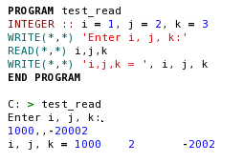
Defaulting Values in List-Directed Input
List-directed READ statements support null values.
If an input data line contains two consecutive commas, the corresponding variable in the input list is left unchanged.
This behavior permits users to default one or more input values
Its also possible to default all remaining values on a line by concluding with a /

Slide 9
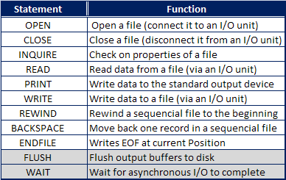
Fortran I/O Statements
These I/O statements permit users to:
Open, and/or close files
Check file status
Go to a specific position within the file
Read or write to a file

Slide 10
The OPEN Statement
OPEN( unit, file, status, action, iostat, iomsg)
UNIT=int_expr clause indicating the i/o unit number to associate with this file.
FILE=char_expr clause specifying the name of the file to be opened.
STATUS=char_expr clause specifying the status of the file to be opened. Where the char_expr is one of the following:
‘OLD’ – Signifies that the file already exists.
‘NEW’ – A new file is created, if a file of the same name exists the open returns an error.
‘REPLACE’ – A new file is created and may overwrite an existing file with the same name.
‘SCRATCH’ – Temporary file that will be deleted automatically when closed
‘UNKOWN’ – We’ll cover in Chapter 14
ACTION=char_expr clause specifying whether a file is to be opened for reading only, for writing only, or for both reading and writing. Where the char_expr is one of the following:
‘READ’
‘WRITE’
‘READWRITE’
IOSTAT=int_var clause specifying the name of an integer variable in which the status of the open operation can be returned.
IOMSG=char_var clause specifying the name of a character variable that will contain a message in an error occurs. (FORTRAN 2003)

Slide 11
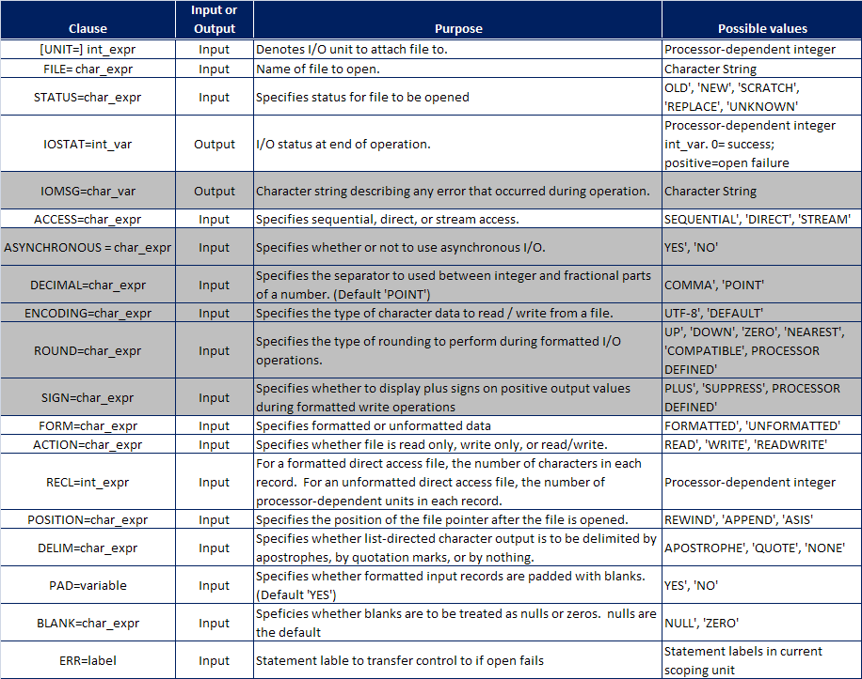

Slide 12
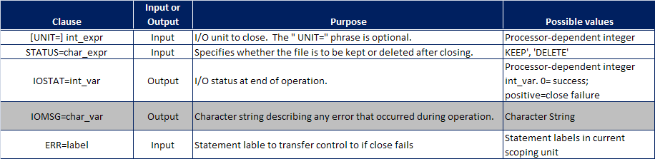
The CLOSE Statement
Releases the File and the I/O unit associated with it.
On program Termination the file closes automatically.
Has the general form:
The close_list consists of one or more clauses separated by commas
CLOSE(close-list)

Slide 13
The INQUIRE Statement
This statement is used to check the status or properties of a file
There are three form:
First form looks files using the FILE= clause. Files may be either Opened or Unopened
Second form looks up the file using the UNIT= clause. Files must be opened.
Third form is the inquire-by-output-list statement
Has the form:
The purpose of this statement is to return the length of the unformatted record that can contain the entries in the output list.
This form provides a processor-independent way to specify the length of records in direct access files
INQUIRE (IOLENGTH=int_var)output_list

Slide 14
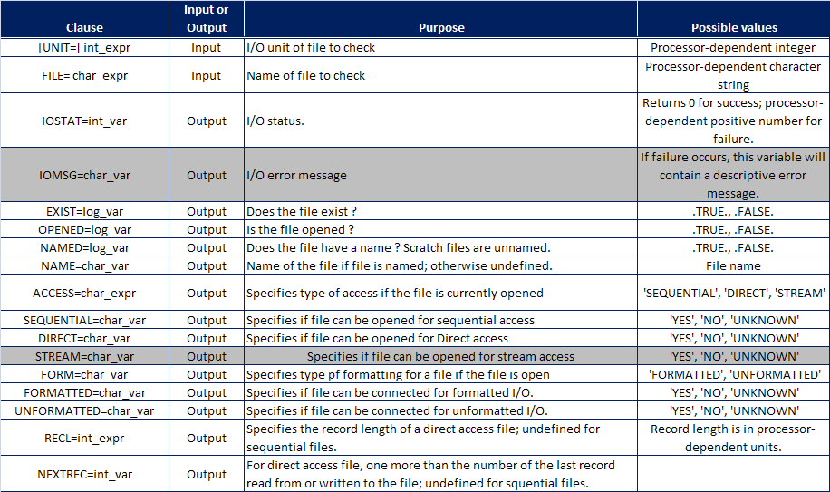

Slide 15
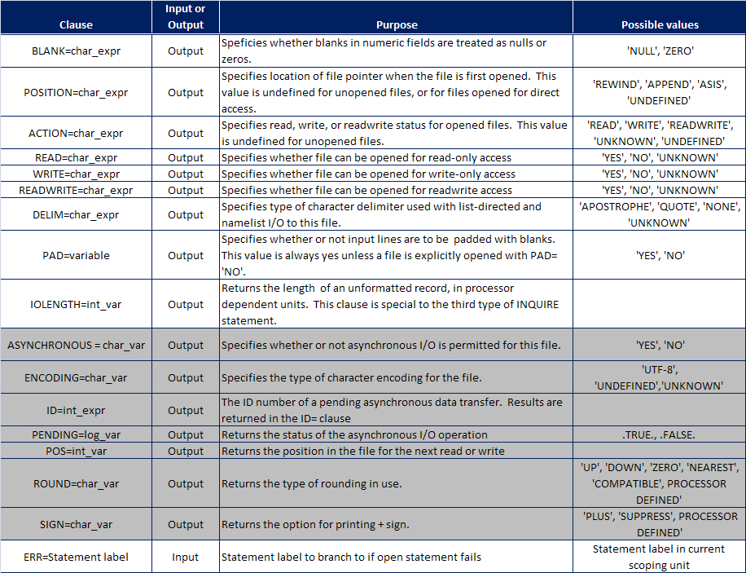

Slide 16
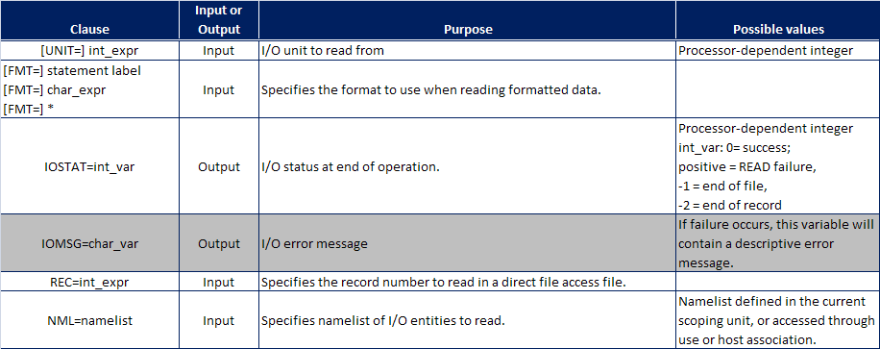
The READ Statement
READ( control_list) iolist
The READ statement:
Reads data from the file associated with a specific I/O unit
Store that data into variable in the iolist

Slide 17
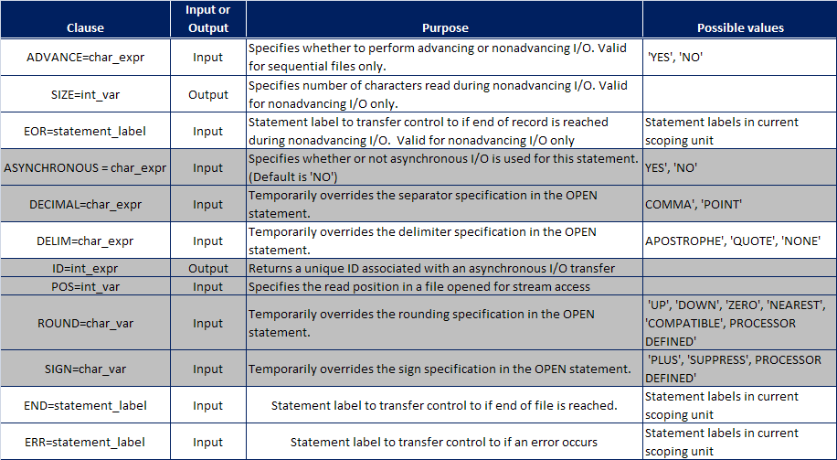

Slide 18
The Write Statement
WRITE( control_list) iolist
WRITE statement:
Converts data in the I/O list according to the specified FORMAT descriptors
Writes it out to the file associated with the specified I/O unit
The clauses in the WRITE statement are the same as those in the READ statement
However there are no END=, SIZE=, or EOR= clauses

Slide 19
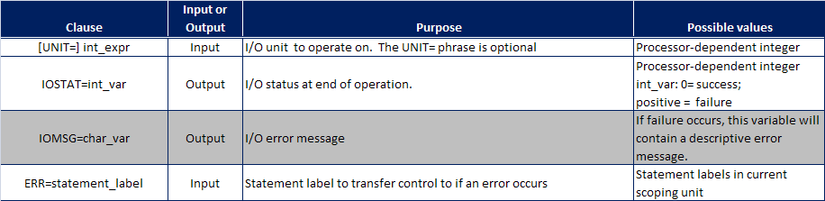
File Positioning
FORTRAN provides two statements that allow us to move around in a sequential file:
BACKSPACE (UNIT=unit)– Moves back one record each time it is called.
REWIND(UNIT=unit)– Moves back to the beginning of the file.

Slide 20
The ENDFILE Statement
The ENDFILE statement
Writes an EOF record at the current position in a sequential file.
Positions the file after the EOF record
No further READs or WRITEs are possible until either a BACKSPACE or REWIND is executed.

Slide 21
New Fortran 2003 I/O Statements
The WAIT Statement
When an asynchronous I/O starts
Execution returns to the Program, this allows the program to run in parallel with the I/O operation.
The WAIT statement is used if, at some point later, the program needs to guarantee the I/O operation is complete before processing continues.
Control is returned only when all pending I/O operations on the designated unit are complete.
The FLUSH Statement
Causes all data written to a file to be posted or otherwise available for use before the statement returns.
This has the effect of forcibly writing any data stored in temporary buffers to disk.

Slide 22
NAMELIST I/O
A namelist is a list of variable names that are read or written as a group.
The form of a namelist is:
The NAMELIST is a specification statement and must appear before the first executable statement.
Variables listed in a NAMELIST may be read or written as unit using namelist-directed I/O statements
A NAMELIST I/O statement looks like a formatted I/O statement except FMT= clause is replaced by the NML= clause.
Unlike most other clauses in I/O statements, the nl_group_name is not enclosed in apostrophes or quotes
NAMELIST / nl_group_name / var1 [, var2, ...]
WRITE(UNIT=8, NML=nl_group_name, [...])

Slide 23
More on NAMELIST
When written out –
All variables are printed out together in a special order
First - &nl_group_name
Next – a series of output values in the form of “NAME=value”
Finally the list is terminated by a “/”
The general form of a NAMELIST-directed READ statement is:
The program searches the input file for the marker &nl_group_name (This indicates the beginning of the namelist)
It then reads all the values in the namelist until a slash (/) is encountered.
Values may appear on any line within the input file between the beginning and end of the namelist.
The READ does not have to set every variable.
Those variables not included are left set to there default values
READ(UNIT=8, NML=nl_group_name, [...])

Slide 24
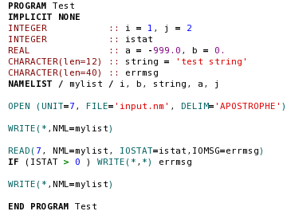
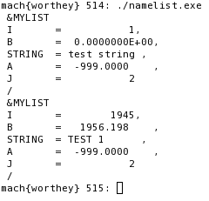
NAMELIST Example

Slide 25
Unformatted Files
All files we have seen so far are formatted files.
They contain recognizable characters, numbers, etc.
Can easily be moved between computers.
The computer must convert this representation to it’s internal representation to use it
These files are inefficient and wasteful of disk space.
Unformatted files are written using the machines internal representation.
Access is faster since no processing time is required to convert it
The data occupies less space so files are smaller.
Usually cannot be moved between different types of processors.
A file may be either FORMATTED or UNFORMATTED, not both.
Declared in the OPEN statement with the FORM= clause
Unformatted I/O statements look just like formatted I/O except the FMT= clause is left out.
WRITE(UNIT=8, IOSTAT=istat) ival

Slide 26
Direct Access Files
These files may be read and written in arbitrary order.
These type of files are useful when the data must be accessed in any order.
Key to operation is that every record must be the same length.
With the record length know the computer can easily determine which record is being requested and access it directly.
Direct Access files are opened using the OPEN statement by:
Specifying ACCESS=‘DIRECT’ and
Specifying the record length using the RECL= clause
Formatted files - record length is specified in units of characters
Unformatted files – record length is specified in units of bytes, words or some other machine dependent quantity.
The third form of the INQUIRE statement can be used to determine the record length in a processor-independent fashion
A typical READ statement is shown below:
Direct access, unformatted files whose record length is a multiple of the sector size of a particular computer are the most efficient Fortran files possible on that computer.
READ(8,‘(I6)’, REC=irec) ival

Slide 27
Steam Access Mode
Stream access mode:
Reads or writes a file byte-by-byte
Treats special characters like any other
Similar I/O functions getc and putc in C
A file is opened in stream access mode by specifying ACCESS=‘STREAM’ in the OPEN statement.
Data can be written out in a series of write statements and the line completed when the newline character is output
The newline character is generated using the intrinsic function new_line(a)
This function returns a newline character of the same KIND as the input character a

Slide 28
Example of a derived-type Input/Output procedure
module m
type point
character(20) label
integer x, y
contains
procedure :: writepoint
generic :: write(formatted) => writepoint
end type
type :: line
type(point) :: p1,p2
contains
procedure :: writeline
generic :: write(formatted) => writeline
end type
contains

Slide 29
subroutine writepoint(dtv, unit, iotype, vlist, iostat, iomsg)
class(point), intent(in) :: dtv
integer, intent(in) :: unit
character(*), intent(in) :: iotype
integer, intent(in) :: vlist(:)
integer, intent(out) :: iostat
character(*), intent(inout) :: iomsg
write(unit, *, iostat=iostat, iomsg=iomsg) &
trim(dtv%label), ': (', dtv%x, ', ', dtv%y, ')'
end subroutine
subroutine writeline(dtv, unit, iotype, vlist, iostat, iomsg)
class(line), intent(in) :: dtv
integer, intent(in) :: dtv
character(*), intent(in) :: iotype
integer, intent(in) :: vlist(:)
integer, intent(out) :: iostat
character(*), intent(inout) :: iomsg
real length, delta_x, delta_y
delta_x = dtv%p2%x - dtv%p1%x
delta_y = dtv%p2%y - dtv%p1%y
length = sqrt(delta_x**2 + delta_y**2)
write(unit, *, iostat=iostat, iomsg=iomsg) &
'Distance from ', dtv%p1, ' to ', dtv%p2, ' is ', length
end subroutine
end module

Slide 30
use m
type(point) :: p = point('Point1', x=1, y=1)
type(line) :: 1
1 = line(p, point('Point2', x=4, y=5))
print *, 1
End
Output:
Distance from Point1: ( 1 , 1 ) to Point2: ( 4 , 5 ) is 5.000000000

Slide 31
DT Editing Descriptor
Purpose
The DT edit descriptor allows you to specify that a user-defined procedure is called instead of the default input/output formatting for processing an input/output list item of derived type
Syntax
DT
DTchar-literal-constant
DT( v-list )
DTchar-literal-constant( v-list )
Rules
The iotype dummy argument passed to the user-defined input/output procedure contains the text from the char-literal-constant, prefixed with DT. If you do not include a char-literal-constant, the iotype argument contains only DT.
The v-list is passed to the user-defined input/output procedure in the v_list integer array dummy argument. If you do not include a v-list, the v_list dummy argument is a zero-sized array.
When you use the DT edit descriptor, the corresponding derived type input/output list item must be associated with an appropriate user-defined derived type input/output procedure.
http://www.fortranlib.com/

Slide 32
Asynchronous I/O
Synchronous: When a program executes I/O, the program execution is halted until the I/O operation is complete
Asynchronous: I/O operations occur in parallel with program execution.
During a write operation:
Data is copied to an internal buffer
The write statement is started
Control instantly returns to the calling program
During a read operation:
The read process is started
Control instantly returns to the calling program
At the time of execution the variables being read are undefined.
These variables must not be used until the read is complete.
FORTRAN 2003 compilers are allowed but not required to implement asynchronous I/O

Slide 33
Problems with Asynchronous I/O
A major problem can occur when Fortran compilers try to optimize execution for speed.
Compilers often move the order of actions around and do things in parallel.
This can cause a problem if a compiler moved a statement using data from a asynchronous READ to a point before the READ operation is complete.
FORTRAN 2003 has defined a new attribute to warn the compiler of this sort of problem, the ASYNCHRONOUS attribute or statement.
The ASYNCHRONOUS attribute is automatically assigned to a variable if it (or a component of it) appears in an I/O list or a namelist associated with an asynchronous I/O statement.

Slide 34
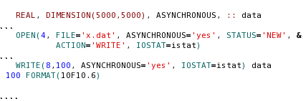
Performing Asynchronous I/O
The file must be opened with the option to allow asynchronous I/O and
Each individual READ and WRITE statement must select the asynchronous I/O option.

Slide 35
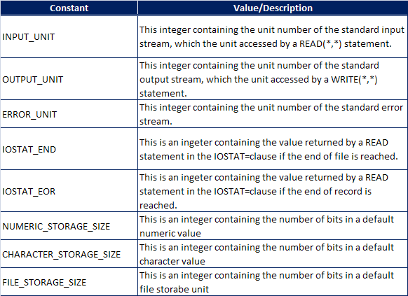
Access to Processor-Specific I/O System Information
A new intrinsic module: ISO_FORTRAN_ENV
Provides a processor-independent way to get information about the I/O system .
Access is though the use of the USE statement.

Slide 36
Good Coding Practice
Always explicitly open each file with an OPEN statement
Always explicitly close each file with a CLOSE statement
Use the IOSAT= and IOMSG= clauses
Trap errors and report them back to the user
Prevent aborting due to EOF or EOR conditions
Use NAMELIST I/O to save data to be exchanged between programs or between different runs of the same program,
Use formatted files to
Create data that must be readable by humans
Transferable between different types of computers.
Use unformatted files to:
Efficiently store large quantities of data
When I/O speed is critical
Use sequential access for data normally read sequentially
Use direct access for data that must be read and written in any order
Use direct access, unformatted files for applications where large amounts of data must be manipulated quickly

